Slide 1
CSE 464 : Software Quality Assurance and Testing
Testing Object Oriented Applications Janaka Balasooriya

Slide 2
Testing Object Oriented Software
OO Testing hierarchy
System Level
Integration
Class Level
Method Level

Slide 3
Testing Object Oriented Software
Various UML artifacts
  Use cases, Sequence diagrams, State Charts, Class Responsibility Collaborator (CRC) diagrams
  http://www.ibm.com/developerworks/rational/library/769.html
OO Testing hierarchy
https://www.ibm.com/developerworks/university/
System Level
Integration
Class Level
Method Level

Slide 4
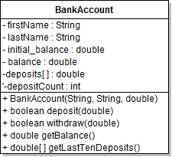
OO Testing Example – Bank Account Example Revisit

Slide 5
BankAccount Testing Example: Demo

Slide 6
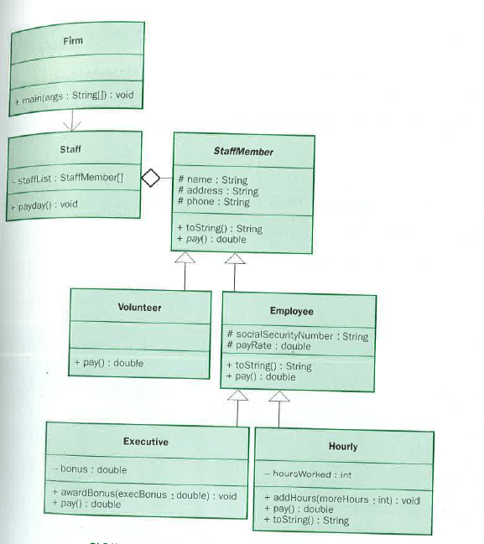
Next Time => How do we Test This Application – Integration Testing?

